Slide 1


Hii, Iam Siddhika
Welcome to Power BI Series
Part -9

Slide 2

Today Content
Are you ready guys?
CREATING A DATA MODEL
WHAT IS A DATA MODEL?
what is not a data model what is a data model
NORMALIZATION

Slide 3
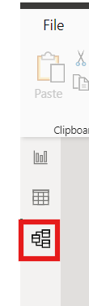


Once you have extracted and transformed your data in Power Query, you can load it into Power BI Desktop. Next we need to do
Do you know where we hava Data Model?
Data Modeling
Data modeling in Power BI is like organizing your data to make it easier to analyze and visualize.

Slide 4

DATA MODELING
It's important because:
It’s Important to check DATA MODEL
Data Organization: It helps organize your data into neat tables, making it easier to understand.
Relationships: It connects different tables so you can analyze data from multiple sources together.
Context: It adds context to your data by describing what each piece of data represents.
Performance: A good data model makes your reports load faster, so you don't have to wait long for insights.

Slide 5
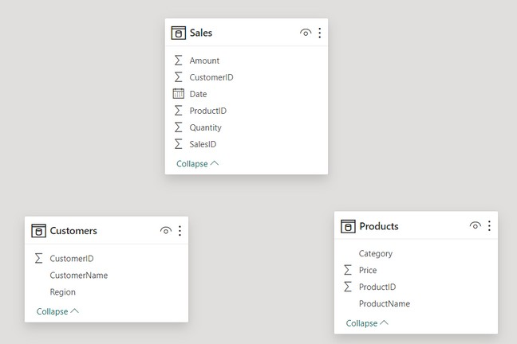

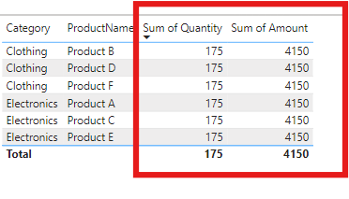
This IS NOT a data model
This is a collection of independent tables, which share no connections or relationships
If you tried to visualize quantity and amount
by Product, this is what you’d get

Slide 6
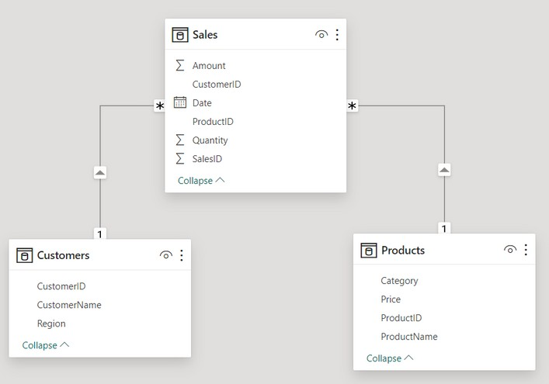

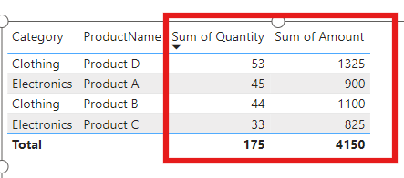
This IS a perfect data model
The tables are connected via relationships, based on a common field (CustomerID and ProductID)
Now Quantity and Amount data can be filtered
using fields from the Product table!

Slide 7

NORMALIZATION
Normalization is like cleaning up your database to make it work better.
Have you Normalized your data?
It's important because:
Less Repeat Info: It removes extra copies of the same stuff, so your database runs faster.
Keep Data Right: It helps your data stay correct and make sense.
Ask Easy Questions: It makes it easier to find things in your data.
Clear Jobs: Each part of your database has its own job, so it's not confusing.

Slide 8


Thank you for joining me today to learn about Part -9 of Power BI!
Remember, a well-organized data model is key to unlocking valuable insights from your data.
Stay tuned for more insights and tips on Power BI in our next Series.
Follow
Siddhika Shah

